Slide 1
Unsupervised Learning: Principle Component Analysis

Slide 2
Slide credits
Most of these slides were adapted from:
Hung-yi Lee (National Taiwan University)
Kris Kitani (Carnegie Mellon University).
Noah Snavely (Cornell University).
Fei-Fei Li (Stanford University).

Slide 3
Unsupervised Learning
We expect unsupervised learning to become far more important in the longer term. Human and animal learning is largely unsupervised: we discover the structure of the world by observing it, not by being told the name of every object. – LeCun, Bengio, Hinton, Nature 2015

Slide 4
As I've said in previous statements: most of human and animal learning is unsupervised learning. If intelligence was a cake, unsupervised learning would be the cake, supervised learning would be the icing on the cake, and reinforcement learning would be the cherry on the cake. We know how to make the icing and the cherry, but we don't know how to make the cake.
– Yann LeCun, March 14, 2016 (Facebook)

Slide 5

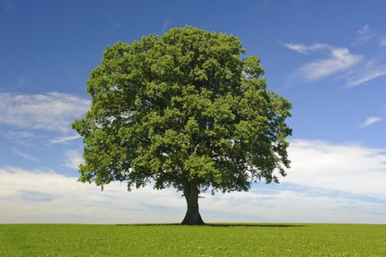
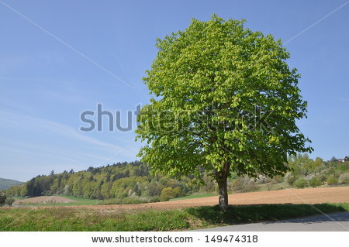
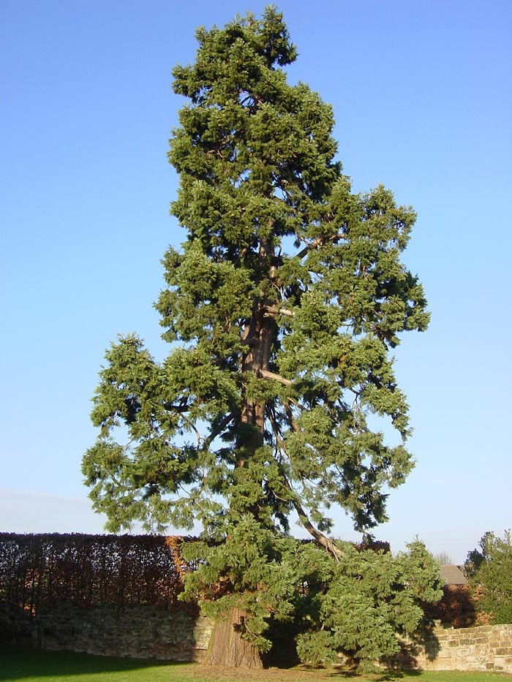
Unsupervised Learning
Clustering & Dimension Reduction (Complex to Simple)
Generation (Out of Noting)
only having function input
only having function output
function
function
Random numbers

Slide 6
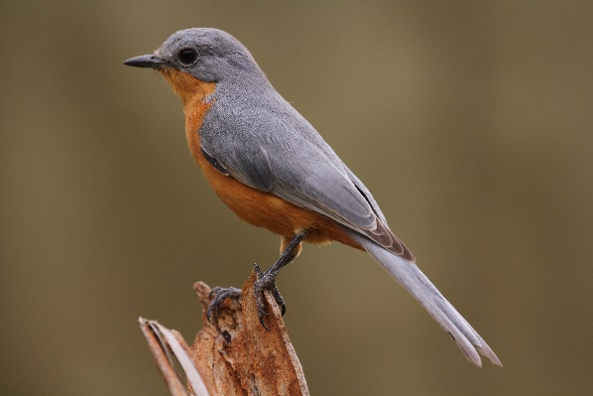
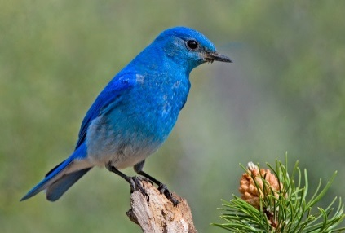
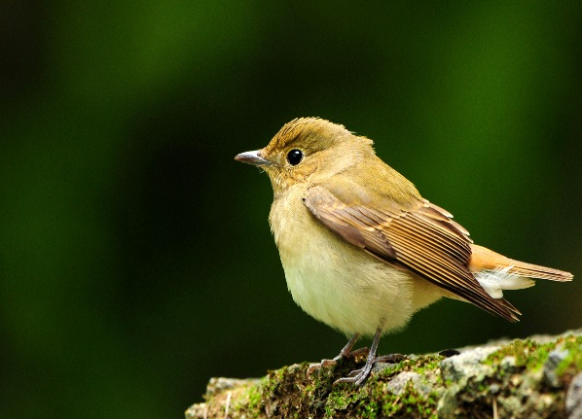
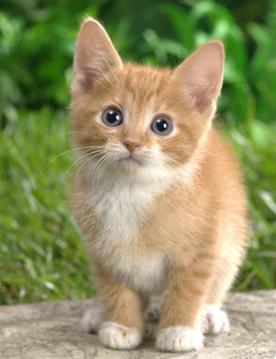
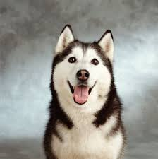


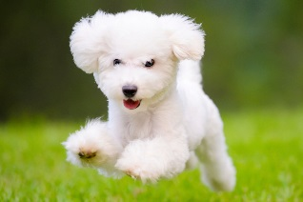
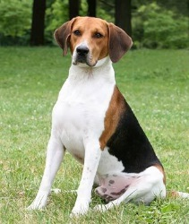
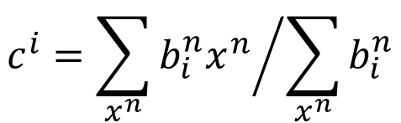





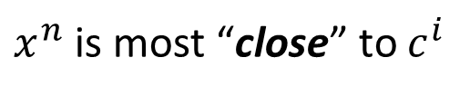
Clustering
$$\left[\begin{aligned}0 \\ 0 \\ 1\end{aligned}\right]$$
Cluster 3
$$\left[\begin{aligned}1 \\ 0 \\ 0\end{aligned}\right]$$
Open question: how many clusters do we need?
K-means
Clustering $X=\left\{x^{1},⋯,x^{n},⋯,x^{N}\right\}$ into K clusters
Initialize cluster center $c^{i}$, i=1,2, … K (K random $x^{n}$ from $X$)
Repeat
For all $x^{n}$ in $X$:
Updating all $c^{i}$:
$$\left[\begin{aligned}0 \\ 1 \\ 0\end{aligned}\right]$$
Cluster 1
Cluster 2
1
$x^{n}$ is most “close” to $c^{i}$
$$b_{i}^{n}$$
0
Otherwise
$$c^{i}={\sum_{x^{n}}{b_{i}^{n}x^{n}}}/{\sum_{x^{n}}{b_{i}^{n}}}$$

Slide 7
Clustering
Hierarchical Agglomerative Clustering (HAC)
root
Step 1: build a tree
Step 2: pick a threshold
Notes:
https://www.semanticscholar.org/paper/Integrating-frame-based-and-segment-based-dynamic-Chan-Lee/7d8eaf612500420a125b3cfca98701114cf68873/pdf

Slide 8
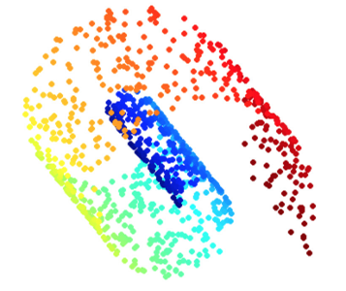
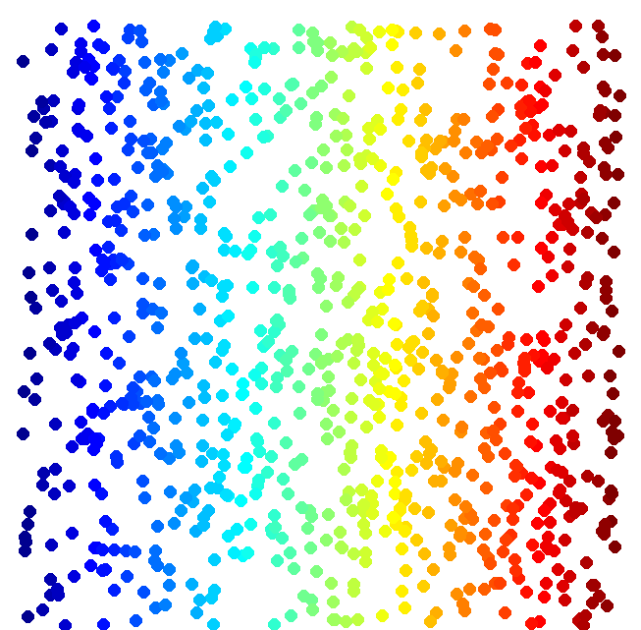
Dimension Reduction
function
vector x
vector z
(High Dim)
(Low Dim)
Looks like 3-D
Actually, 2-D
Notes:
http://reuter.mit.edu/blue/images/research/manifold.png
http://archive.cnx.org/resources/51a9b2052ae167db310fda5600b89badea85eae5/isomapCNXtrue1.png

Slide 9

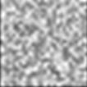
Dimension Reduction
In MNIST, a digit is 28 x 28 dims.
Most 28 x 28 dim vectors are not digits
3
3
3
3
3
-20。
-10。
0。
10。
20。

Slide 10


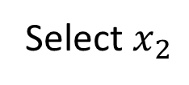

Dimension Reduction
function
Feature selection
Principle component analysis (PCA)
vector x
vector z
(High Dim)
(Low Dim)
$$x_{2}$$
Select $x_{2}$
$$x_{1}$$
[Bishop, Chapter 12]
$$z=Wx$$

Slide 11
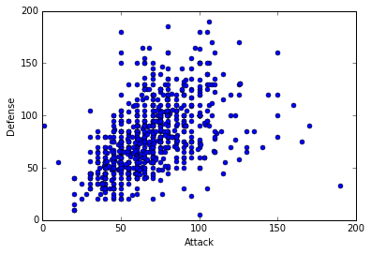


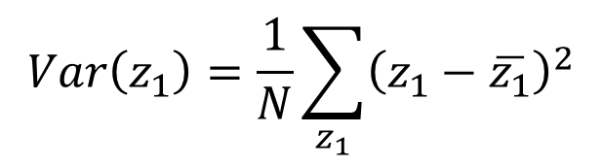


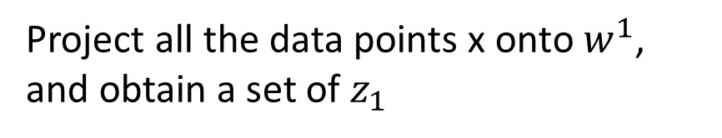



PCA
$$z=Wx$$
Large variance
Reduce to 1-D:
$$z_{1}=w^{1}∙x$$
Small variance
$$x$$
Project all the data points x onto $w^{1}$, and obtain a set of $z_{1}$
$$w^{1}$$
We want the variance of $z_{1}$ as large as possible
$$Var\left(z_{1}\right)=\frac{1}{N}\sum_{z_{1}}{{\left(z_{1}−\overline{z_{1}}\right)}^{2}}$$
$$z_{1}=w^{1}∙x$$
$${\left\|w^{1}\right\|}_{2}=1$$

Slide 12
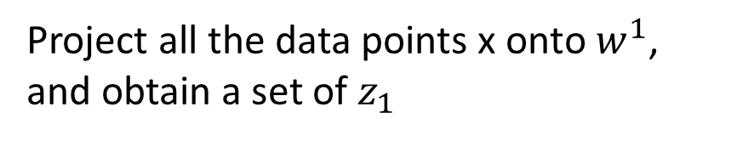
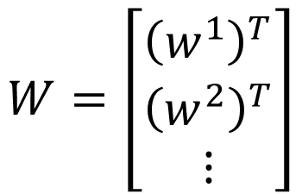
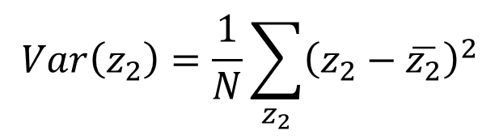




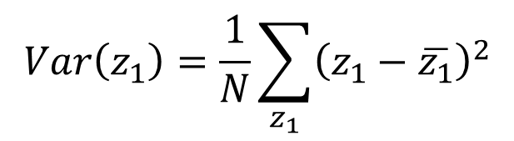


PCA
Project all the data points x onto $w^{1}$, and obtain a set of $z_{1}$
We want the variance of $z_{1}$ as large as possible
$$z=Wx$$
Reduce to 1-D:
$$Var\left(z_{1}\right)=\frac{1}{N}\sum_{z_{1}}{{\left(z_{1}−\overline{z_{1}}\right)}^{2}}$$
$${\left\|w^{1}\right\|}_{2}=1$$
$$z_{1}=w^{1}∙x$$
$$z_{2}=w^{2}∙x$$
We want the variance of $z_{2}$ as large as possible
$$W=\left[\begin{aligned}{\left(w^{1}\right)}^{T} \\ {\left(w^{2}\right)}^{T} \\ ⋮\end{aligned}\right]$$
$$Var\left(z_{2}\right)=\frac{1}{N}\sum_{z_{2}}{{\left(z_{2}−\overline{z_{2}}\right)}^{2}}$$
$${\left\|w^{2}\right\|}_{2}=1$$
$$w^{1}∙w^{2}=0$$
Orthogonal matrix

Slide 13
Warning of Math

Slide 14

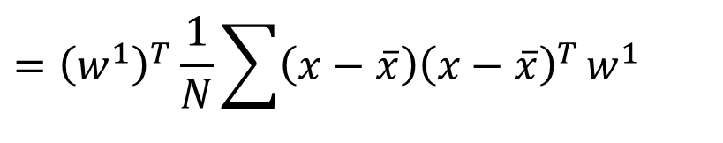
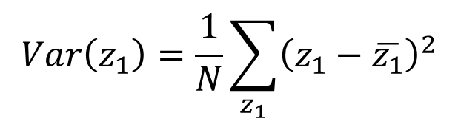
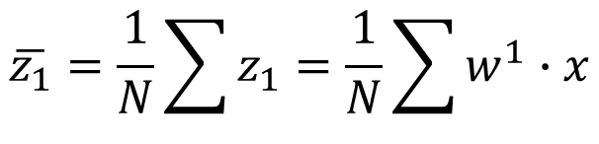
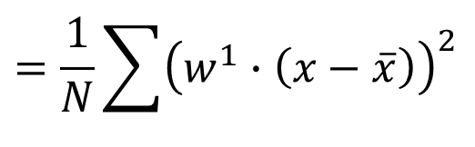
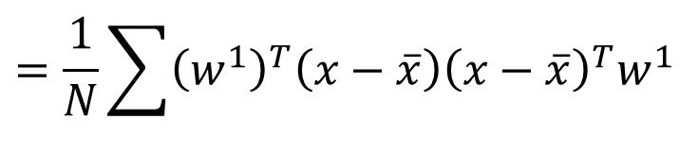



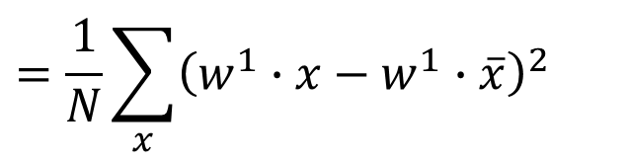








PCA
$$z_{1}=w^{1}∙x$$
$$\overline{z_{1}}=\frac{1}{N}\sum{z_{1}}=\frac{1}{N}\sum{w^{1}∙x}$$
$$=w^{1}∙\frac{1}{N}\sum{x}$$
$$=w^{1}∙\overline{x}$$
$$Var\left(z_{1}\right)=\frac{1}{N}\sum_{z_{1}}{{\left(z_{1}−\overline{z_{1}}\right)}^{2}}$$
$${\left(a∙b\right)}^{2}={\left(a^{T}b\right)}^{2}$$
$$=a^{T}ba^{T}b$$
$$=\frac{1}{N}\sum_{x}{{\left(w^{1}∙x−w^{1}∙\overline{x}\right)}^{2}}$$
$$=a^{T}b{\left(a^{T}b\right)}^{T}$$
$$=a^{T}bb^{T}a$$
$$=\frac{1}{N}\sum{{\left(w^{1}∙\left(x−\overline{x}\right)\right)}^{2}}$$
Find $w^{1}$ maximizing
$$=\frac{1}{N}\sum{{\left(w^{1}\right)}^{T}\left(x−\overline{x}\right){\left(x−\overline{x}\right)}^{T}w^{1}}$$
$${\left(w^{1}\right)}^{T}Sw^{1}$$
$$={\left(w^{1}\right)}^{T}\frac{1}{N}\sum{\left(x−\overline{x}\right){\left(x−\overline{x}\right)}^{T}}w^{1}$$
$${\left\|w^{1}\right\|}_{2}={\left(w^{1}\right)}^{T}w^{1}=1$$
$$={\left(w^{1}\right)}^{T}Cov\left(x\right)w^{1}$$
$$S=Cov\left(x\right)$$

Slide 15
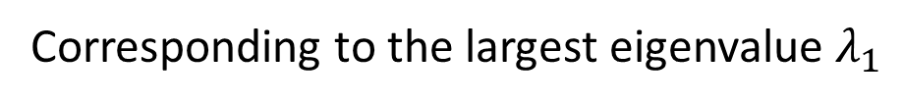


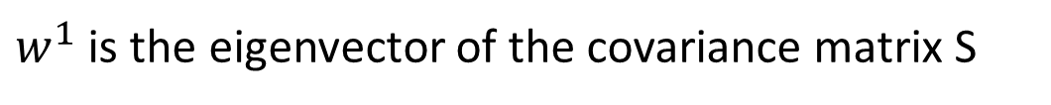

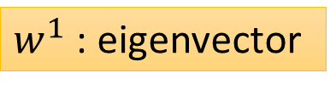

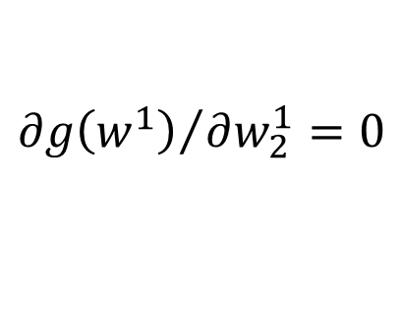


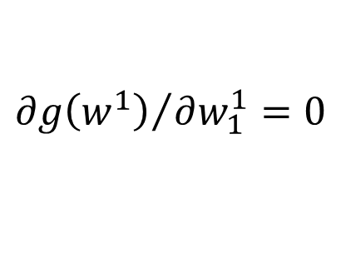


Find $w^{1}$ maximizing
$${\left(w^{1}\right)}^{T}Sw^{1}$$
$${\left(w^{1}\right)}^{T}w^{1}=1$$
$$S=Cov\left(x\right)$$
Symmetric
Positive-semidefinite
(non-negative eigenvalues)
Using Lagrange multiplier [Bishop, Appendix E]
$g\left(w^{1}\right)=$ ${\left(w^{1}\right)}^{T}Sw^{1}−α\left({\left(w^{1}\right)}^{T}w^{1}−1\right)$
$${∂g\left(w^{1}\right)}/{∂w_{1}^{1}=0}$$
$$Sw^{1}−αw^{1}=0$$
$$Sw^{1}=αw^{1}$$
$w^{1}$ : eigenvector
$${∂g\left(w^{1}\right)}/{∂w_{2}^{1}=0}$$
…
$${\left(w^{1}\right)}^{T}Sw^{1}=α{\left(w^{1}\right)}^{T}w^{1}$$
$$=α$$
Choose the maximum one
$w^{1}$ is the eigenvector of the covariance matrix S
Corresponding to the largest eigenvalue $λ_{1}$
Notes:
• The eigenvalues for symmetric matrices are always real.
a symmetric {\displaystyle n} × {\displaystyle n} real matrix {\displaystyle M} is said to be positive definite if the scalar {\displaystyle z^{\mathrm {T} }Mz} is positive for every non-zero column vector {\displaystyle z} of {\displaystyle n} real numbers
zTMz>=0
Ref: http://speech.ee.ntu.edu.tw/~tlkagk/courses/LA_2016/Lecture/special%20matrix%20(v2).ecm.mp4/index.html

Slide 16
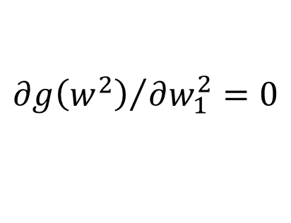



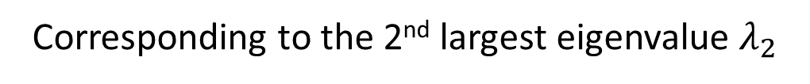


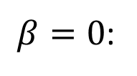


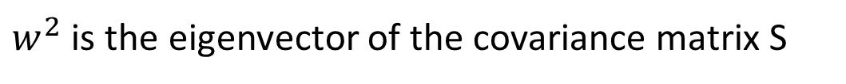





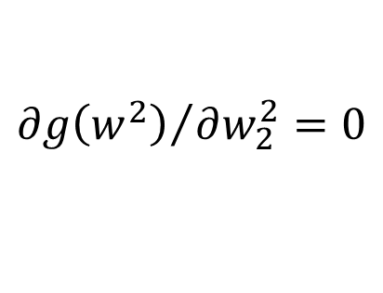


Find $w^{2}$ maximizing
$${\left(w^{2}\right)}^{T}Sw^{2}$$
$${\left(w^{2}\right)}^{T}w^{2}=1$$
$${\left(w^{2}\right)}^{T}w^{1}=0$$
$g\left(w^{2}\right)=$ ${\left(w^{2}\right)}^{T}Sw^{2}−α\left({\left(w^{2}\right)}^{T}w^{2}−1\right)$
$$−β\left({\left(w^{2}\right)}^{T}w^{1}−0\right)$$
$${∂g\left(w^{2}\right)}/{∂w_{1}^{2}=0}$$
$$Sw^{2}−αw^{2}−βw^{1}=0$$
0
0
1
$${\left(w^{1}\right)}^{T}Sw^{2}−α{\left(w^{1}\right)}^{T}w^{2}−β{\left(w^{1}\right)}^{T}w^{1}=0$$
$${∂g\left(w^{2}\right)}/{∂w_{2}^{2}=0}$$
$$={\left({\left(w^{1}\right)}^{T}Sw^{2}\right)}^{T}$$
$$={\left(w^{2}\right)}^{T}S^{T}w^{1}$$
…
$$={\left(w^{2}\right)}^{T}Sw^{1}$$
$$=λ_{1}{\left(w^{2}\right)}^{T}w^{1}$$
$$=0$$
$$Sw^{1}=λ_{1}w^{1}$$
$β=0$:
$$Sw^{2}−αw^{2}=0$$
$$Sw^{2}=αw^{2}$$
$w^{2}$ is the eigenvector of the covariance matrix S
Corresponding to the 2nd largest eigenvalue $λ_{2}$

Slide 17
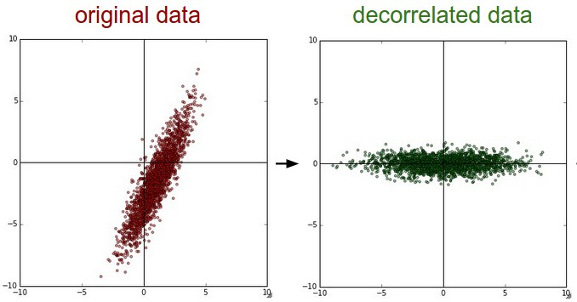












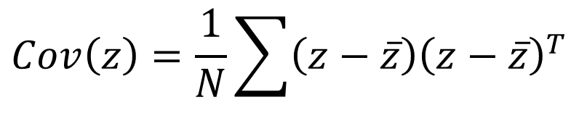


PCA - decorrelation
$$x_{2}$$
$$z_{2}$$
$$z=Wx$$
$$x_{1}$$
$$z_{1}$$
$$Cov\left(z\right)=D$$
PCA
Diagonal matrix
$$Cov\left(z\right)=\frac{1}{N}\sum{\left(z−\overline{z}\right){\left(z−\overline{z}\right)}^{T}}$$
$$=WSW^{T}$$
$$S=Cov\left(x\right)$$
$$=WS\left[\begin{matrix}w^{1} & ⋯ & w^{K}\end{matrix}\right]$$
$$=W\left[S\begin{matrix}w^{1} & ⋯ & Sw^{K}\end{matrix}\right]$$
$$=W\left[λ_{1}\begin{matrix}w^{1} & ⋯ & λ_{K}w^{K}\end{matrix}\right]$$
$$=\left[λ_{1}\begin{matrix}{Ww}^{1} & ⋯ & λ_{K}{Ww}^{K}\end{matrix}\right]$$
$$=\left[λ_{1}\begin{matrix}e_{1} & ⋯ & λ_{K}e_{K}\end{matrix}\right]$$
$$=D$$
Diagonal matrix

Slide 18
End of Warning
Notes:
http://stats.stackexchange.com/questions/2691/making-sense-of-principal-component-analysis-eigenvectors-eigenvalues

Slide 19

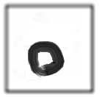

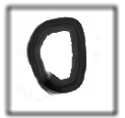




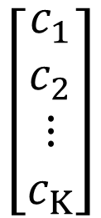
PCA – Another Point of View
Basic Component:
1
0
1
0
1
…….
u¹
u²
u³
u⁴
u⁵
$$\left[\begin{aligned}1 \\ 0 \\ 1 \\ 0 \\ 1 \\ ⋮\end{aligned}\right]$$
1x
1x
1x
$$≈$$
+
+
u¹
u³
u⁵
$$\left[\begin{aligned}c_{1} \\ c_{2} \\ ⋮ \\ c_{K}\end{aligned}\right]$$
$$x≈c_{1}u^{1}+c_{2}u^{2}+⋯+c_{K}u^{K}+\overline{x}$$
Represent a digit image
Pixels in a digit image
component
Notes:
https://pvirie.wordpress.com/2016/03/29/linear-autoencoders-do-pca/
https://pvirie.wordpress.com/2013/10/01/pattern-covariance-analysis-of-components/

Slide 20

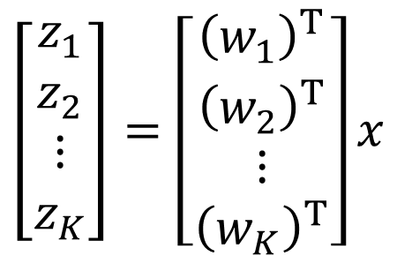

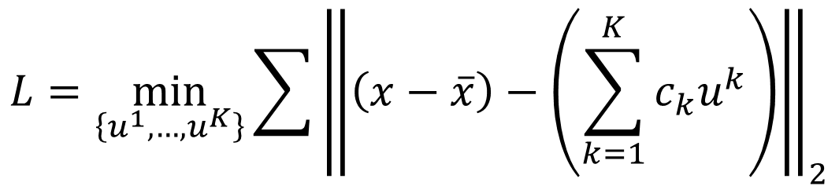

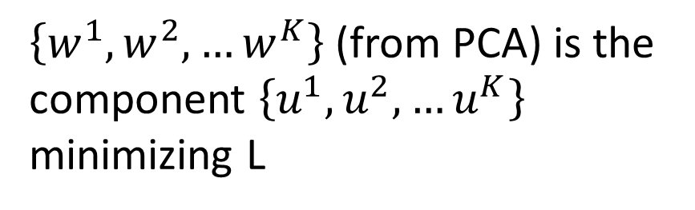


PCA – Another Point of View
$$x−\overline{x}≈c_{1}u^{1}+c_{2}u^{2}+⋯+c_{K}u^{K}$$
$$=\hat{x}$$
Reconstruction error:
$${\left\| (x−\overline{x})−\hat{x}\right\|}_{2}$$
Find $\left\{u^{1},…,u^{K}\right\}$ minimizing the error
$$L=\min_{\left\{u^{1},…,u^{K}\right\}}{\sum{{\left\|\left(x−\overline{x}\right)−\left(\sum_{k=1}^{K}{c_{k}u^{k}}\right)\right\|}_{2}}}$$
PCA:
$$z=Wx$$
$$\hat{x}$$
$$\left[\begin{aligned}z_{1} \\ z_{2} \\ ⋮ \\ z_{K}\end{aligned}\right]=\left[\begin{aligned}{\left(w_{1}\right)}^{T} \\ {\left(w_{2}\right)}^{T} \\ ⋮ \\ {\left(w_{K}\right)}^{T}\end{aligned}\right]x$$
$\left\{w^{1},w^{2},…w^{K}\right\}$ (from PCA) is the component $\left\{u^{1},u^{2},…u^{K}\right\}$ minimizing L
Proof in [Bishop, Chapter 12.1.2]

Slide 21













$$x−\overline{x}≈c_{1}u^{1}+c_{2}u^{2}+⋯+c_{K}u^{K}$$
$$=\hat{x}$$
Reconstruction error:
$${\left\| (x−\overline{x})−\hat{x}\right\|}_{2}$$
Find $\left\{u^{1},…,u^{K}\right\}$ minimizing the error
$$x^{1}−\overline{x}≈c_{1}^{1}u^{1}+c_{2}^{1}u^{2}+⋯$$
$$x^{2}−\overline{x}≈c_{1}^{2}u^{1}+c_{2}^{2}u^{2}+⋯$$
$$x^{3}−\overline{x}≈c_{1}^{3}u^{1}+c_{2}^{3}u^{2}+⋯$$
……
u¹
u²
$$c_{1}^{1}$$
$$c_{1}^{2}$$
$$c_{1}^{3}$$
…
$$≈$$
$$c_{2}^{2}$$
…
$$c_{2}^{1}$$
$$c_{2}^{3}$$
Minimize Error
…
…
…
Matrix X
Notes:
Link PCA with MDS
[1] T. Cox and M. Cox. Multidimensional Scaling. Chapman Hall, Boca Raton, 2nd edition, 2001.

Slide 22









$$x^{1}−\overline{x}$$
u¹
u²
$$c_{1}^{1}$$
$$c_{1}^{2}$$
$$c_{1}^{3}$$
…
$$≈$$
…
$$c_{2}^{1}$$
$$c_{2}^{2}$$
$$c_{2}^{3}$$
Minimize Error
…
…
…
Matrix X
M x N
M x K
K x K
K x N
X
U
∑
V
$$≈$$
K columns of U: a set of orthonormal eigen vectors corresponding to the K largest eigenvalues of XX^{T}
This is the solution of PCA
SVD (Singular Value Decomposition)

Slide 23



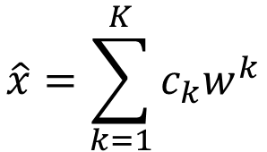





PCA looks like a neural network with one hidden layer (linear activation function)
Autoencoder
If $\left\{w^{1},w^{2},…w^{K}\right\}$ is the component $\left\{u^{1},u^{2},…u^{K}\right\}$
$$\hat{x}=\sum_{k=1}^{K}{c_{k}w^{k}}$$
To minimize reconstruction error:
$$x−\overline{x}$$
$$c_{k}=\left(x−\overline{x}\right)∙w^{k}$$
$K=2$:
$$w_{1}^{1}$$
$$c_{1}$$
$$x−\overline{x}$$
$$w_{2}^{1}$$
$$w_{3}^{1}$$
Notes:
$$K=2$$

Slide 24





PCA looks like a neural network with one hidden layer (linear activation function)
Autoencoder
If $\left\{w^{1},w^{2},…w^{K}\right\}$ is the component $\left\{u^{1},u^{2},…u^{K}\right\}$
$$\hat{x}=\sum_{k=1}^{K}{c_{k}w^{k}}$$
To minimize reconstruction error:
$$x−\overline{x}$$
$$c_{k}=\left(x−\overline{x}\right)∙w^{k}$$
$K=2$:
$$c_{1}$$
$$x−\overline{x}$$
$$w_{1}^{2}$$
$$c_{2}$$
$$w_{2}^{2}$$
$$w_{3}^{2}$$
Notes:
$$K=2$$

Slide 25






PCA looks like a neural network with one hidden layer (linear activation function)
Autoencoder
If $\left\{w^{1},w^{2},…w^{K}\right\}$ is the component $\left\{u^{1},u^{2},…u^{K}\right\}$
$$\hat{x}=\sum_{k=1}^{K}{c_{k}w^{k}}$$
To minimize reconstruction error:
$$x−\overline{x}$$
$$c_{k}=\left(x−\overline{x}\right)∙w^{k}$$
$K=2$:
$$w_{1}^{1}$$
$${\hat{x}}_{1}$$
$$c_{1}$$
$$w_{2}^{1}$$
$$x−\overline{x}$$
$$w_{1}^{2}$$
$${\hat{x}}_{2}$$
$$c_{2}$$
$$w_{3}^{1}$$
$$w_{2}^{2}$$
$$w_{3}^{2}$$
$${\hat{x}}_{3}$$
Notes:
$$K=2$$

Slide 26




PCA looks like a neural network with one hidden layer (linear activation function)
Autoencoder
If $\left\{w^{1},w^{2},…w^{K}\right\}$ is the component $\left\{u^{1},u^{2},…u^{K}\right\}$
$$\hat{x}=\sum_{k=1}^{K}{c_{k}w^{k}}$$
To minimize reconstruction error:
$$x−\overline{x}$$
$$c_{k}=\left(x−\overline{x}\right)∙w^{k}$$
$K=2$:
It can be deep.
Deep Autoencoder
$${\hat{x}}_{1}$$
$$c_{1}$$
Minimize error
$$w_{1}^{2}$$
$$x−\overline{x}$$
$${\hat{x}}_{2}$$
$$x−\overline{x}$$
$$w_{1}^{2}$$
$$c_{2}$$
$$w_{2}^{2}$$
$$w_{2}^{2}$$
Gradient Descent?
$$w_{3}^{2}$$
$${\hat{x}}_{3}$$
$$w_{3}^{2}$$
Notes:
Gradient descent is different

Slide 27


PCA - MNIST
$$=a_{1}w^{1}+a_{2}w^{2}+⋯$$
images
30 components:
Eigen-digits

Slide 28


PCA - Face
30 components:
http://www.cs.unc.edu/~lazebnik/research/spring08/assignment3.html
Eigen-face
Notes:
Example of an original image of ORL face database

Slide 29


Weakness of PCA
Unsupervised
Linear
PCA
LDA
http://www.astroml.org/book_figures/chapter7/fig_S_manifold_PCA.html
Notes:
Project to 1 dimension/

Slide 30


Weakness of PCA
Pixel (28x28) -> PCA (2)
Pixel (28x28) -> tSNE (2)

Slide 31

Appendix
http://4.bp.blogspot.com/_sHcZHRnxlLE/S9EpFXYjfvI/AAAAAAAABZ0/_oEQiaR3WVM/s640/dimensionality+reduction.jpg
https://lvdmaaten.github.io/publications/papers/TR_Dimensionality_Reduction_Review_2009.pdf

